Slide 1
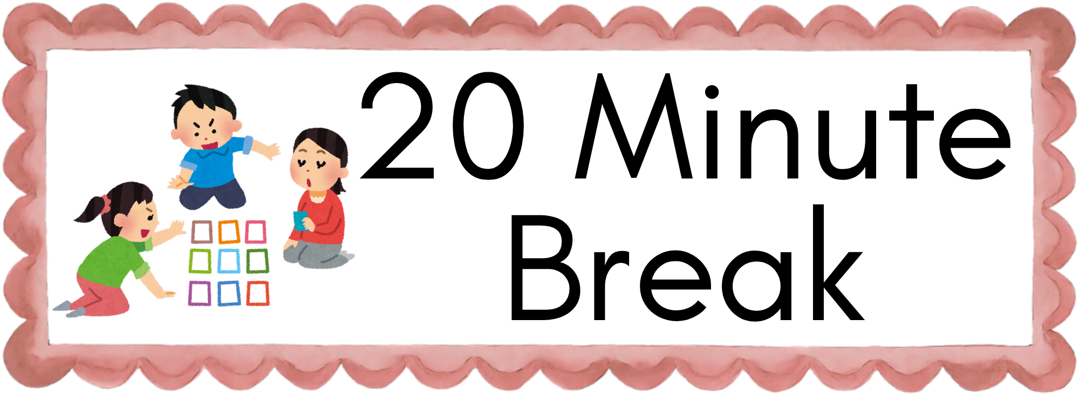
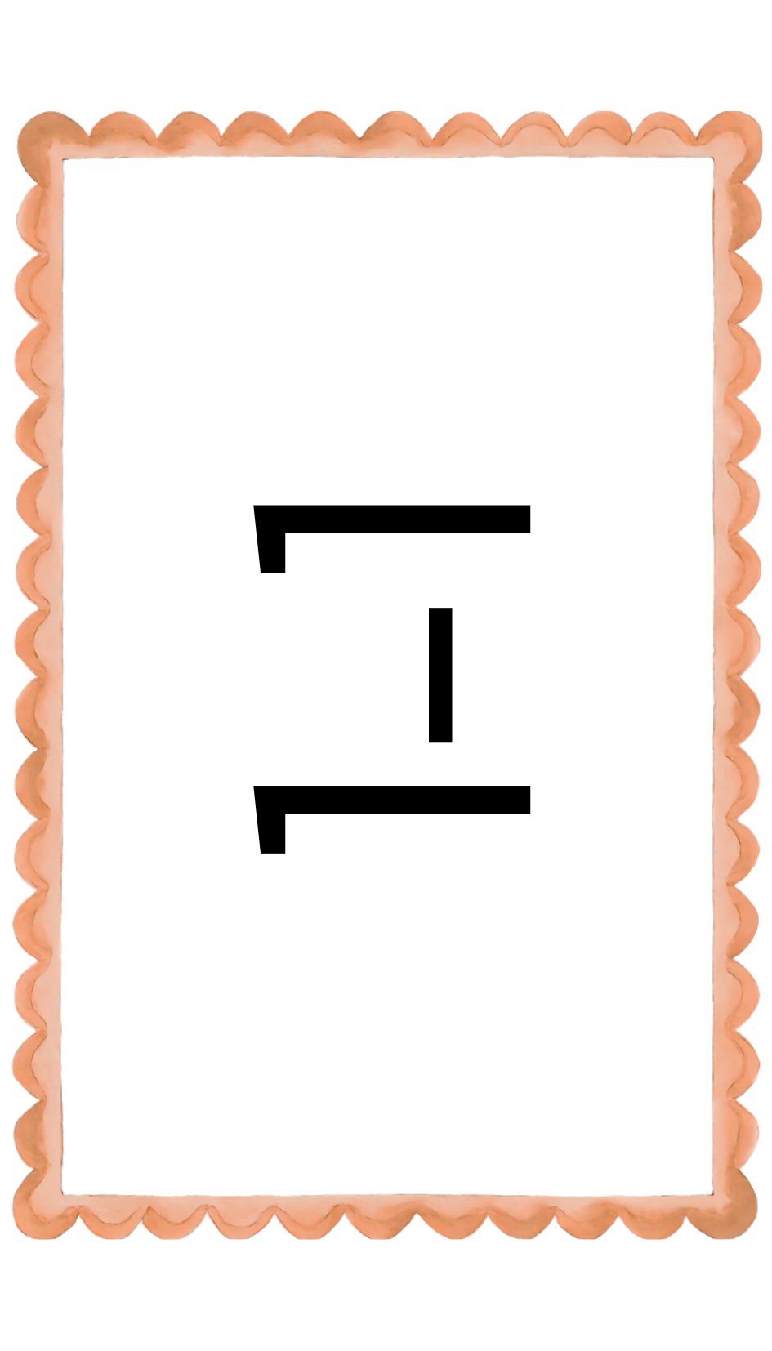


Slide 2

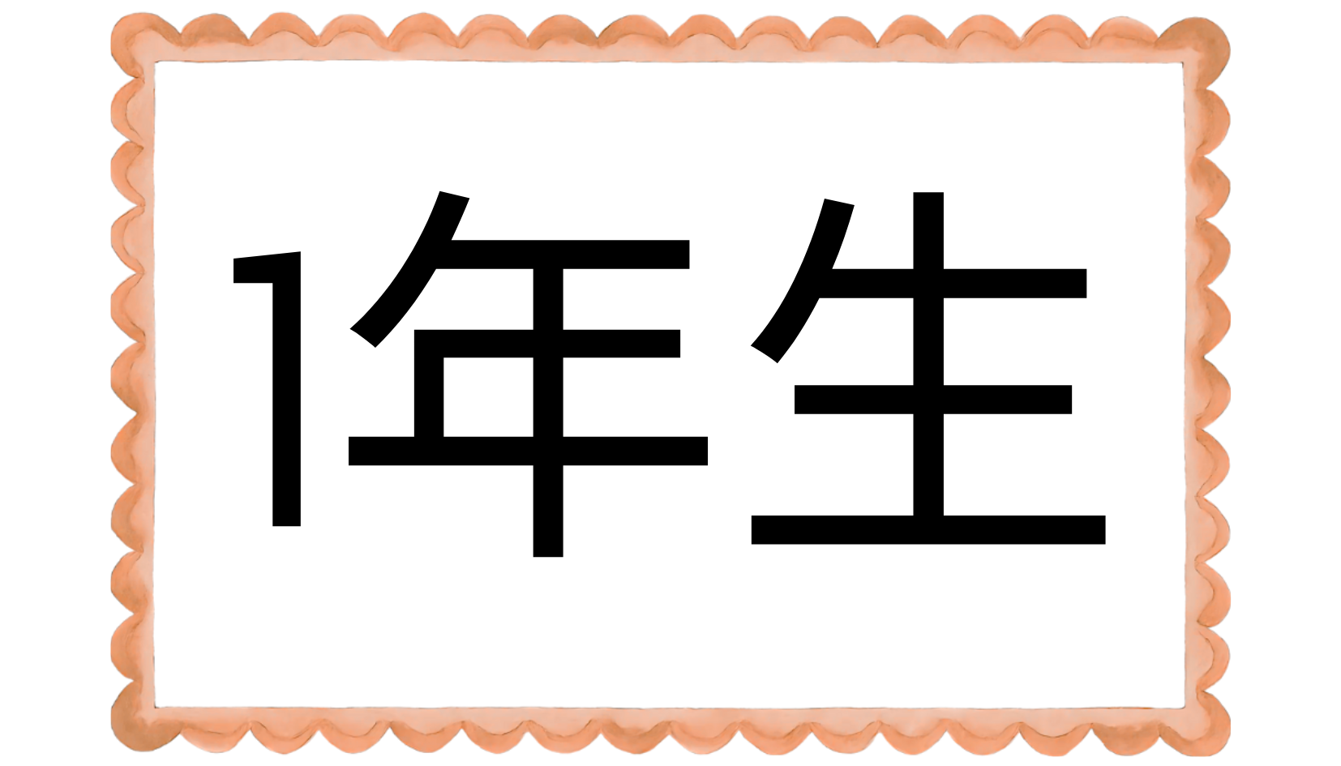
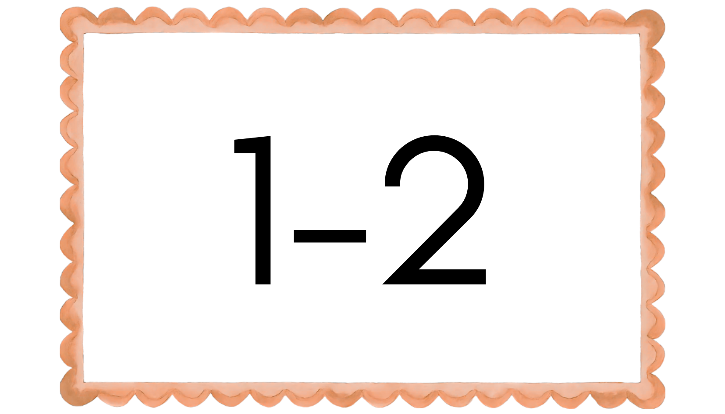

Slide 3
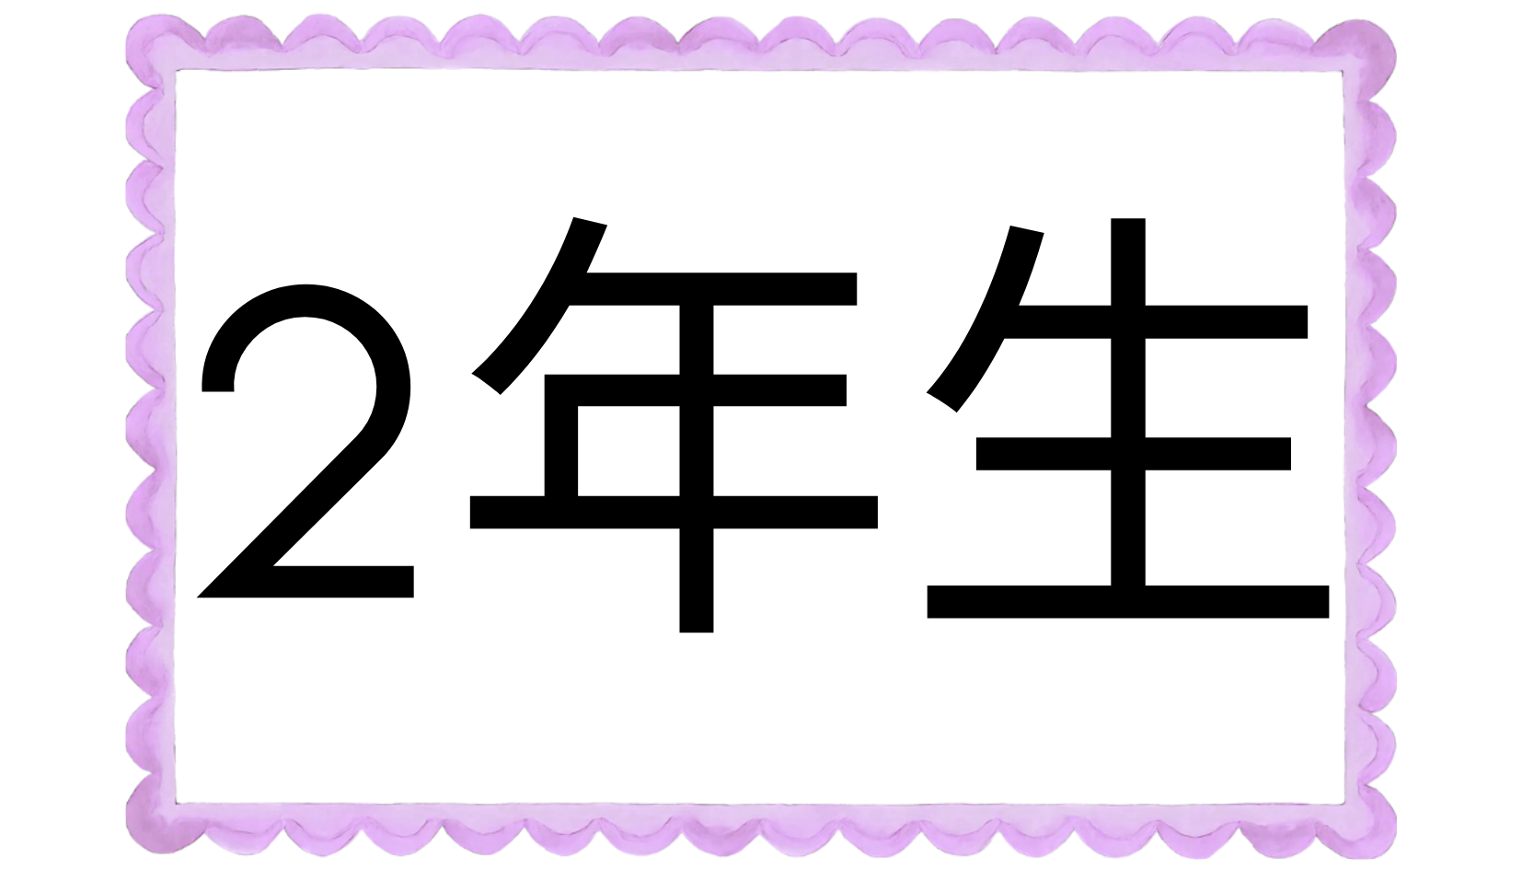
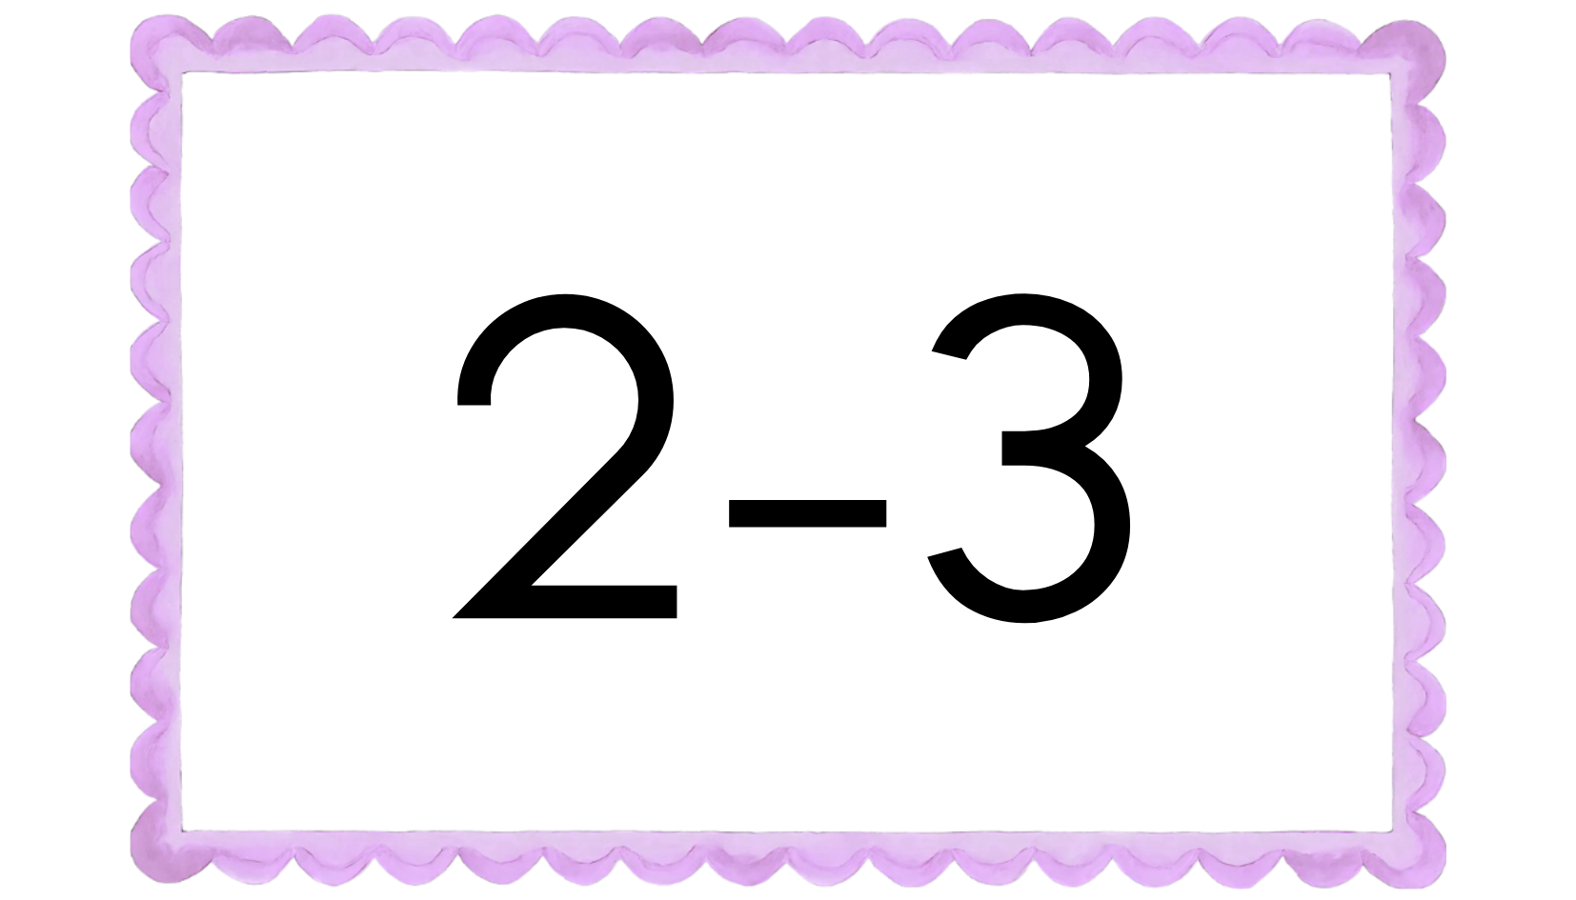
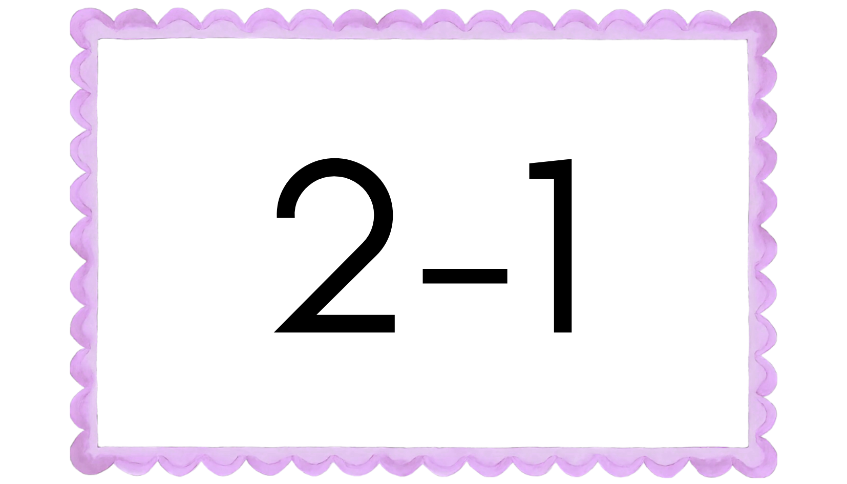
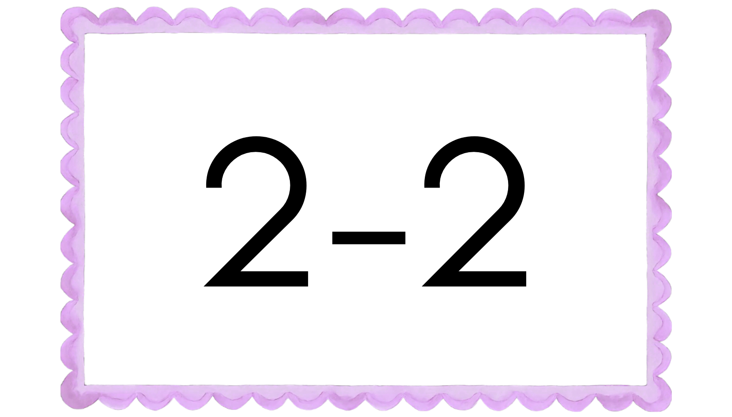

Slide 4
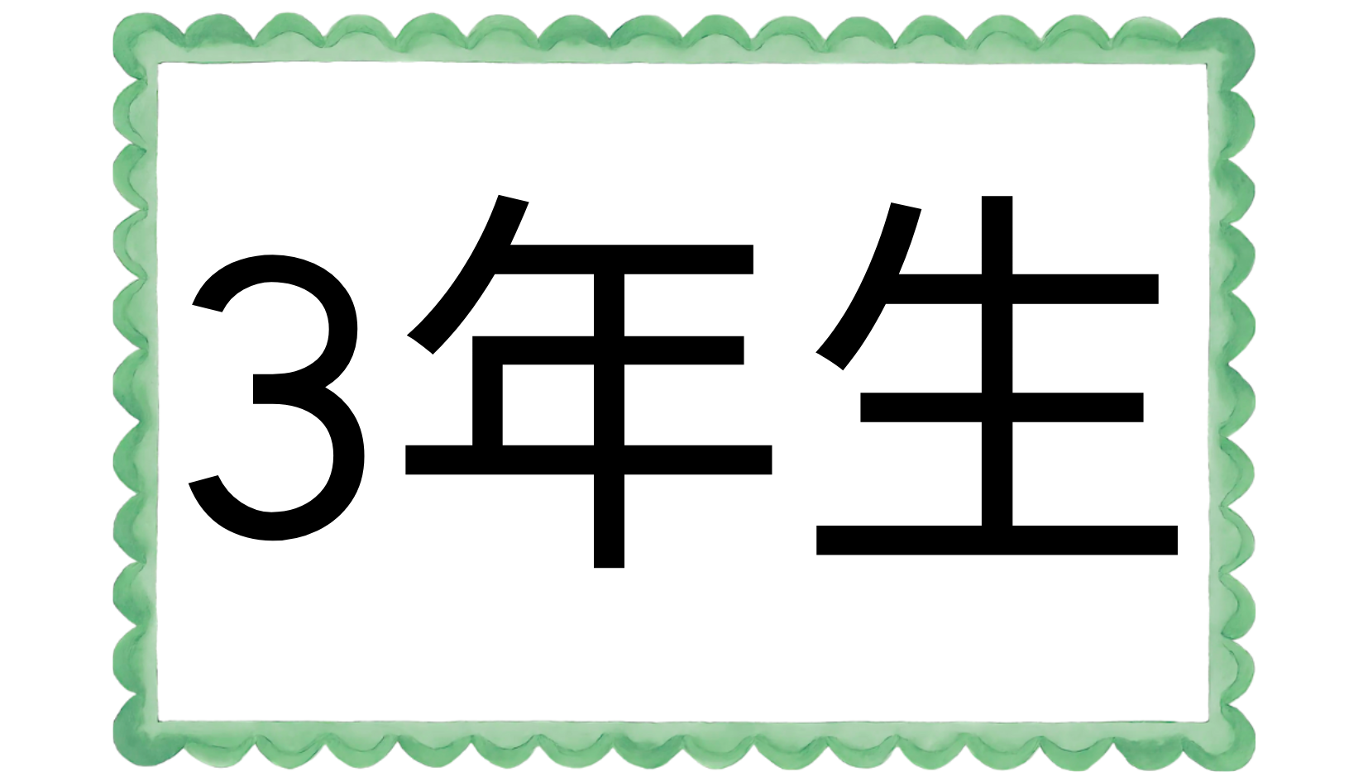
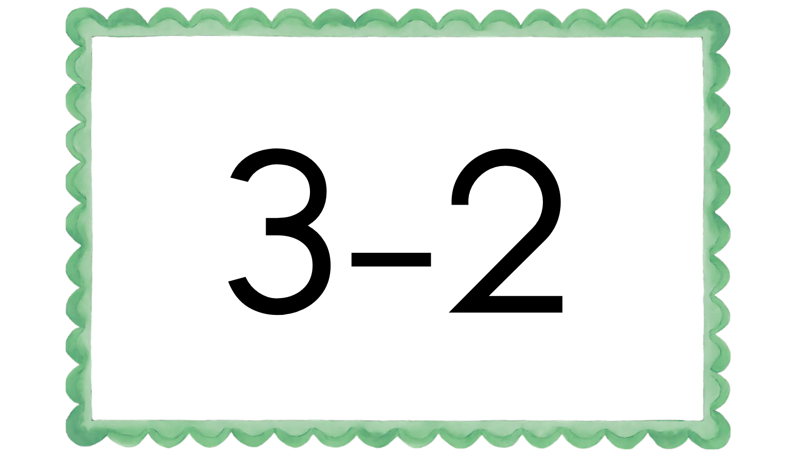
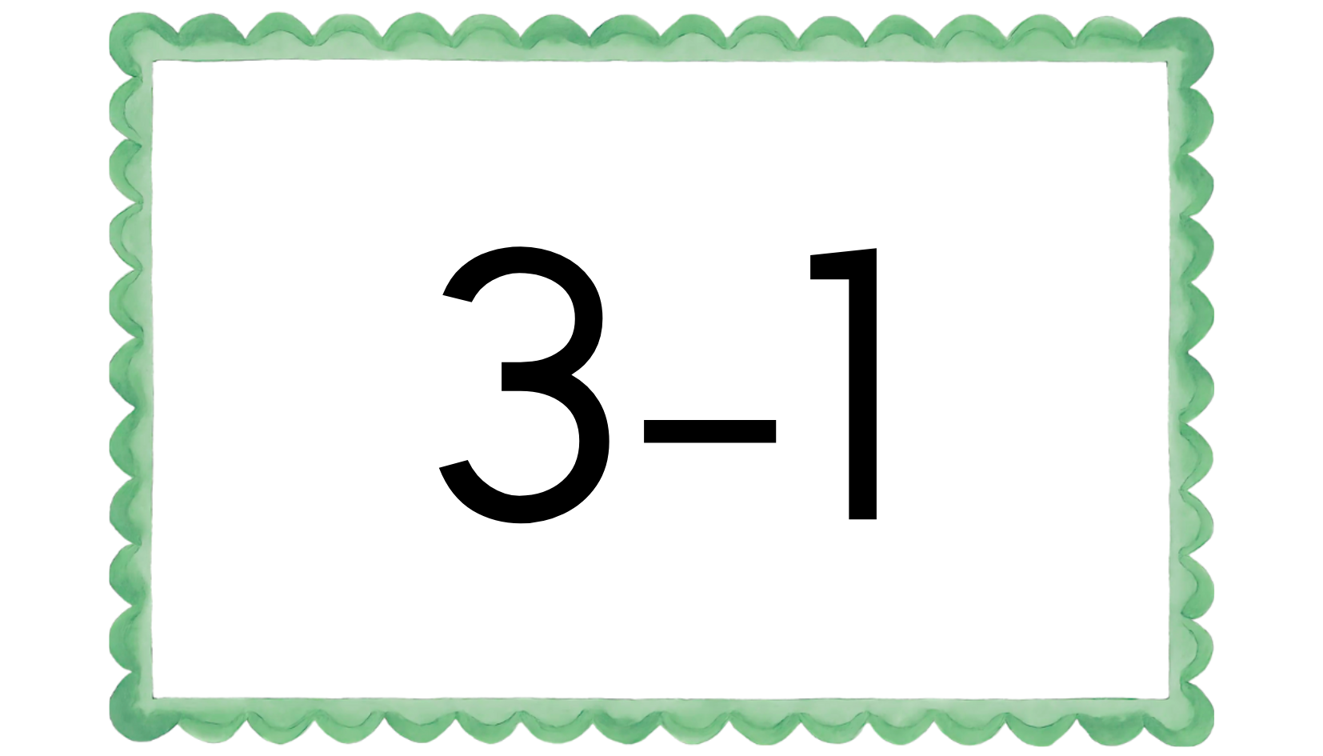
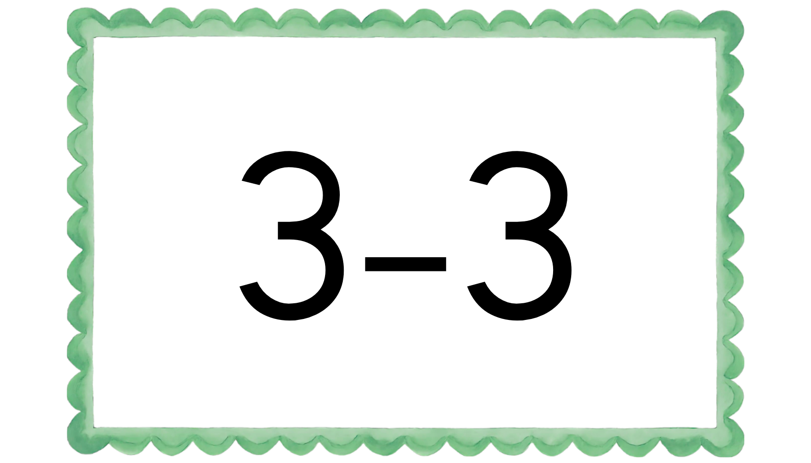

Slide 5
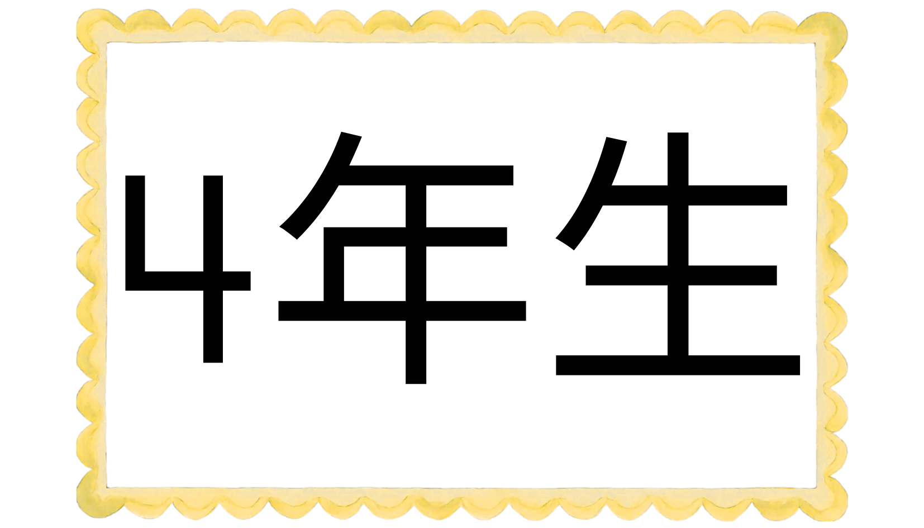
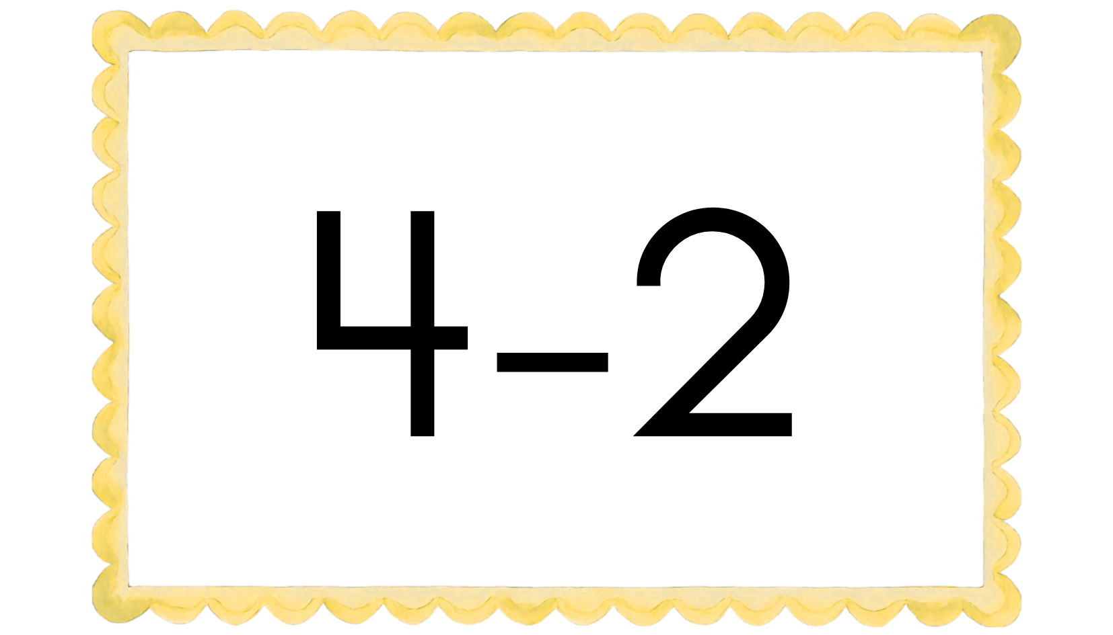
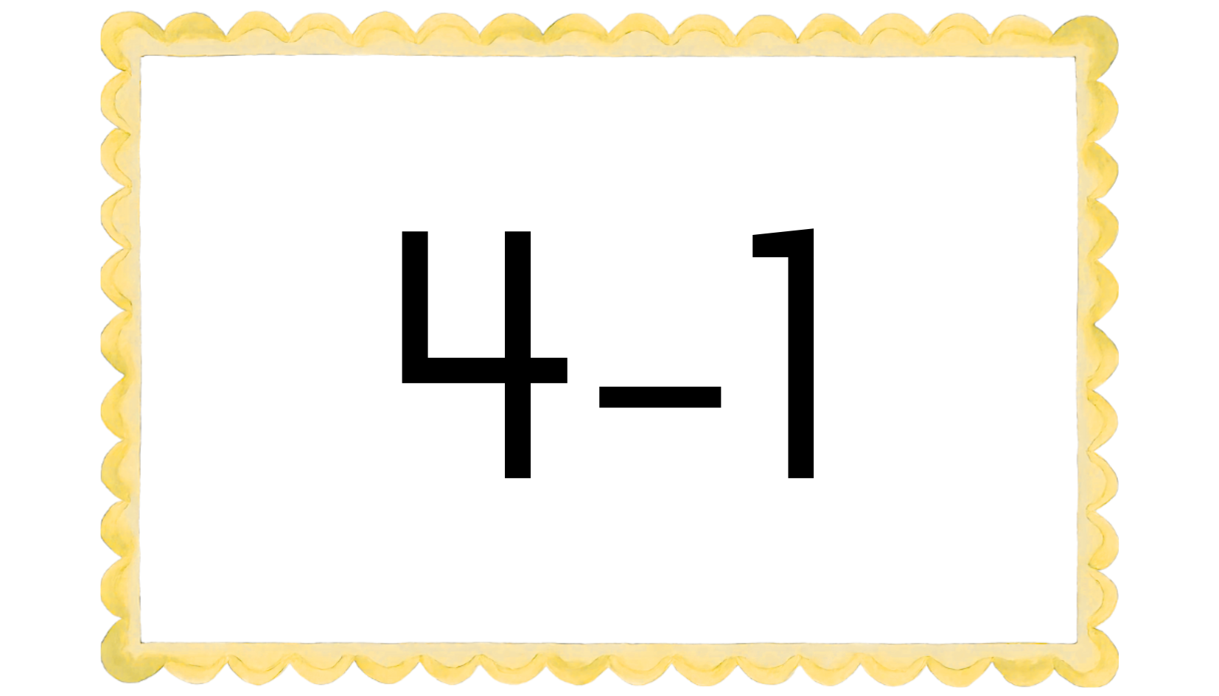
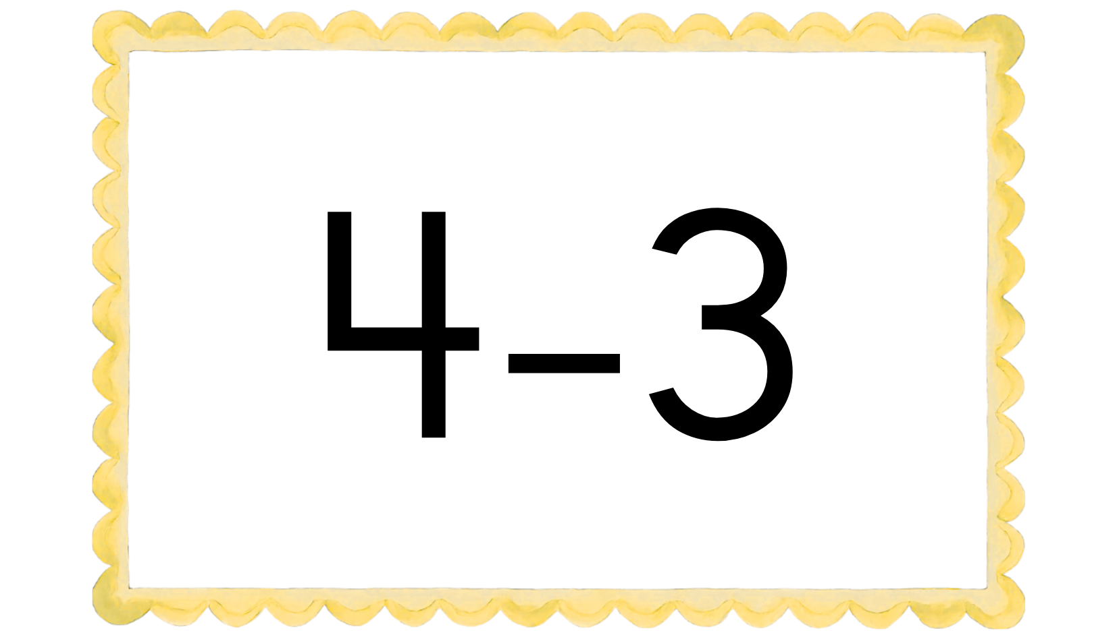

Slide 6
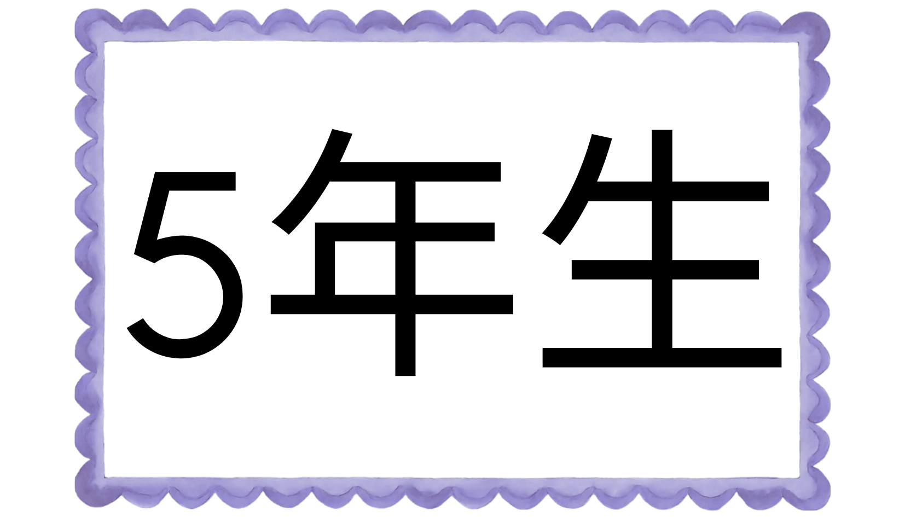
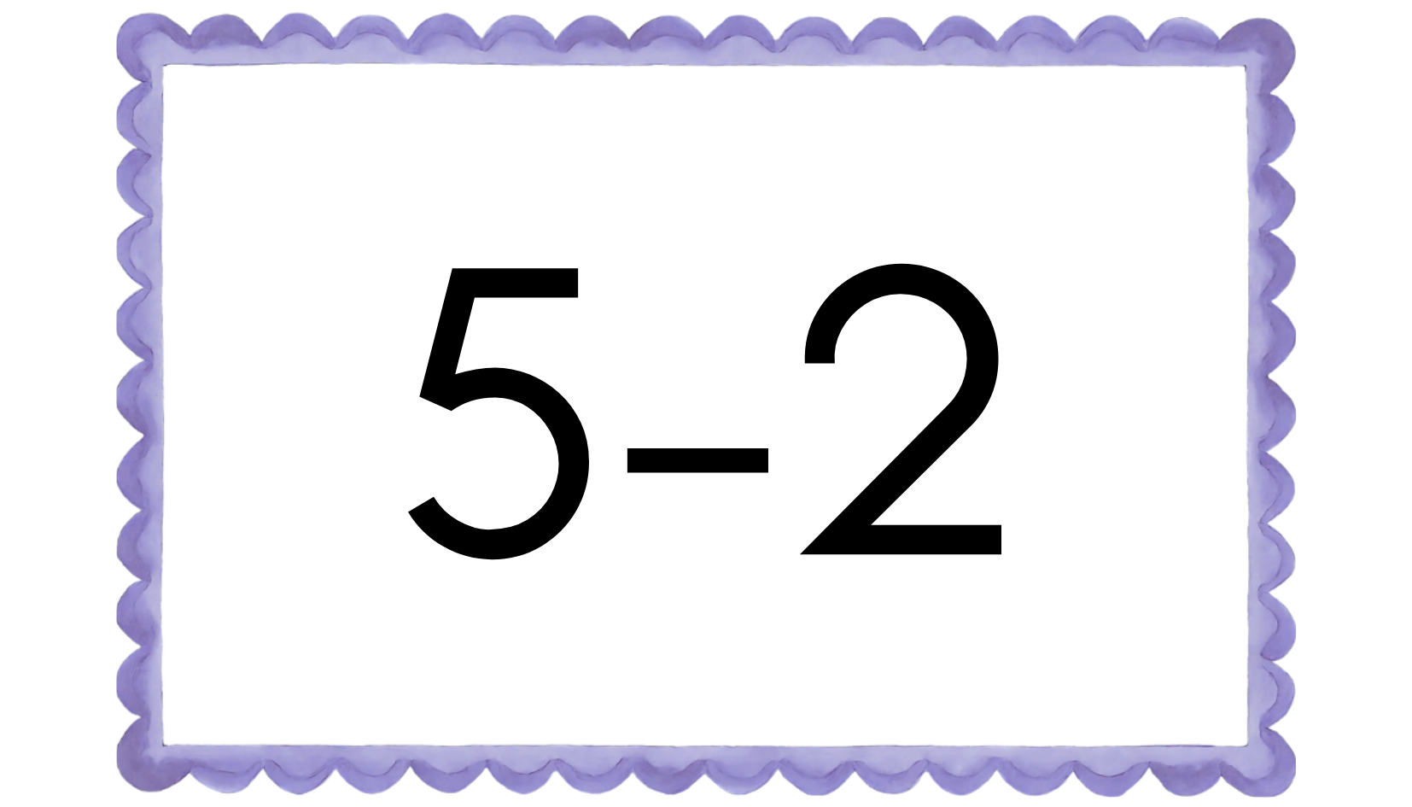
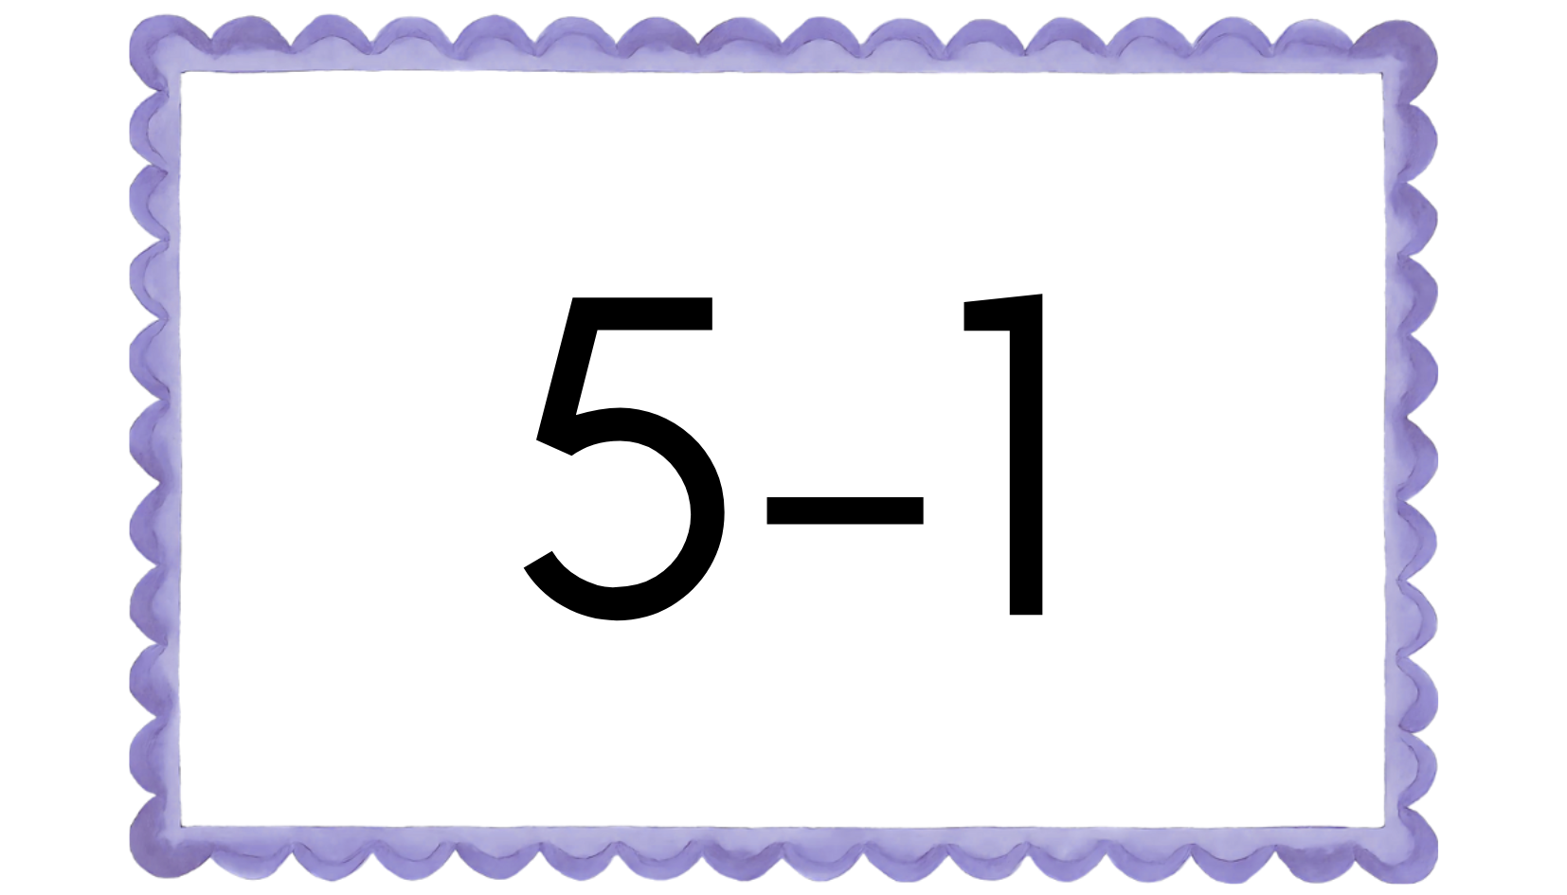
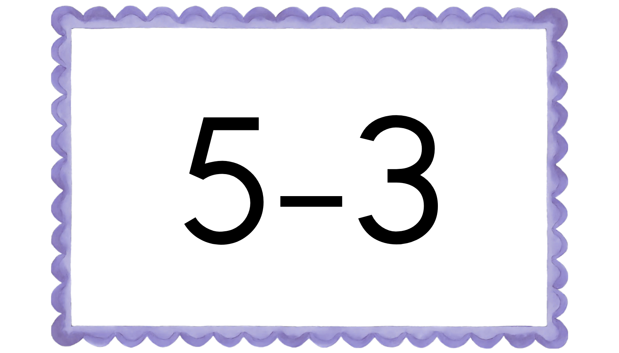

Slide 7
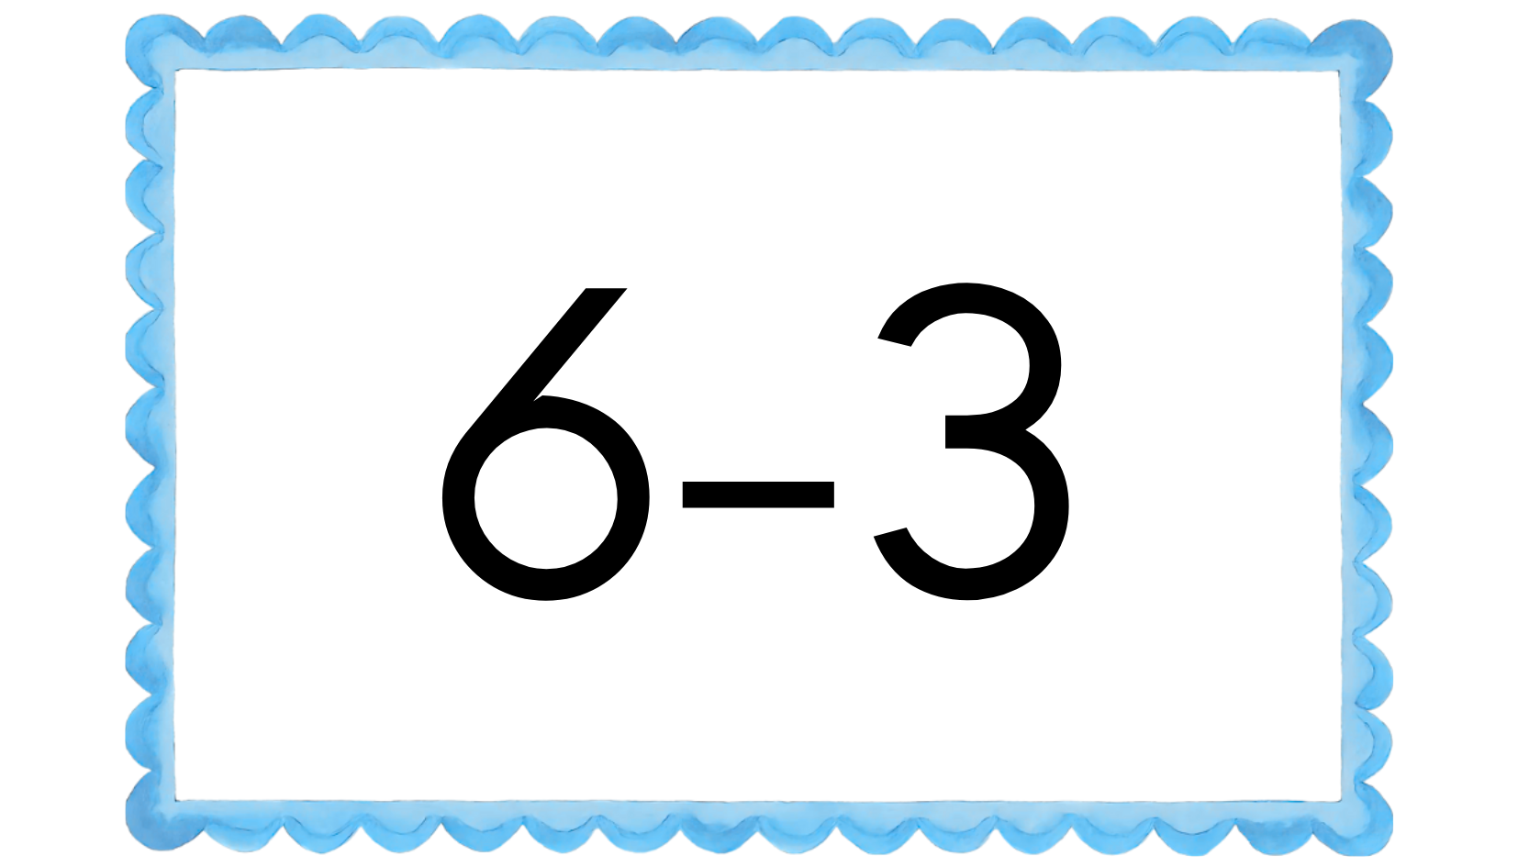
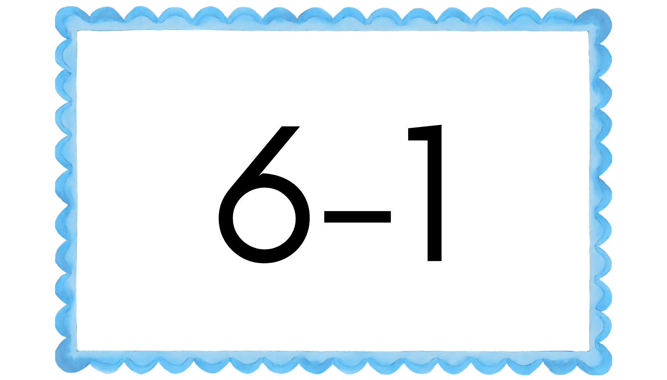
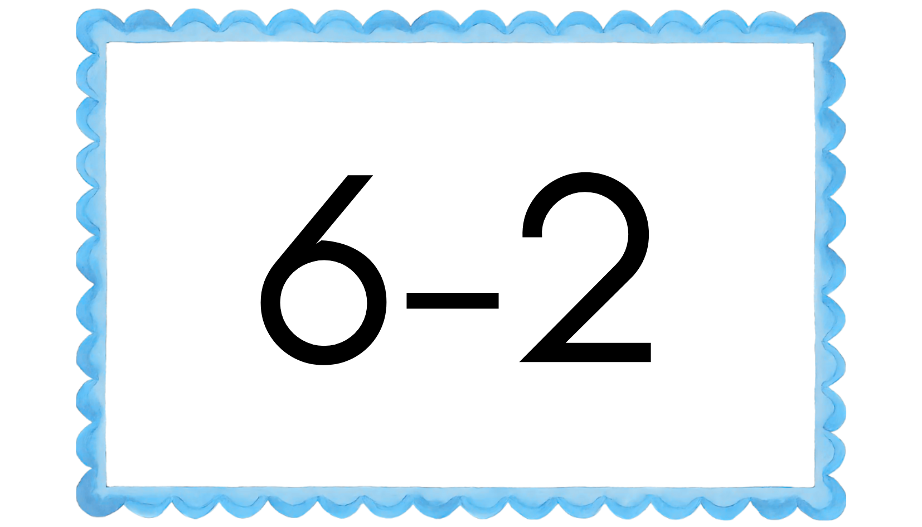
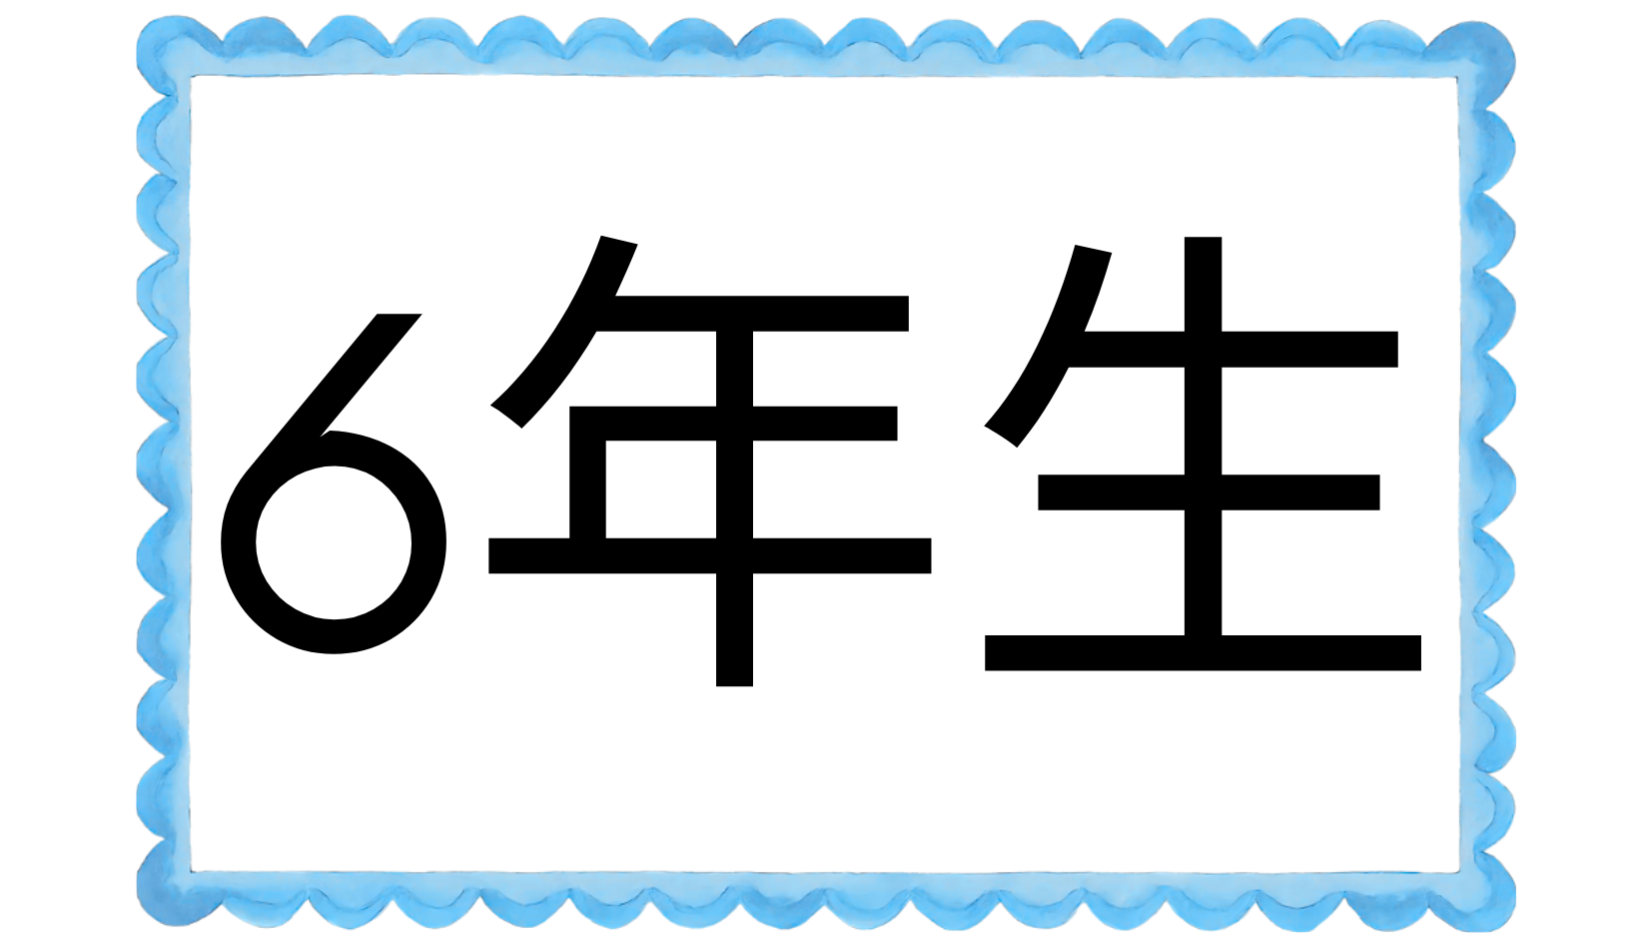

Slide 8



Slide 9











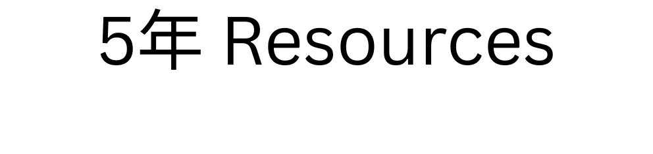





















Slide 10

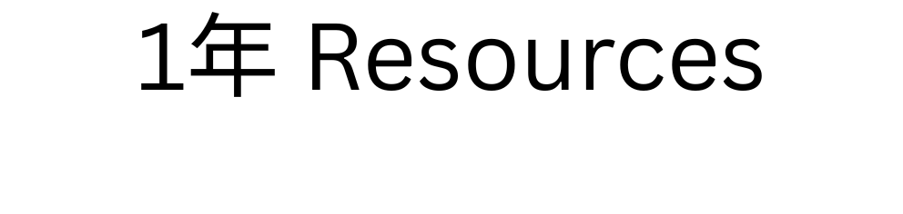



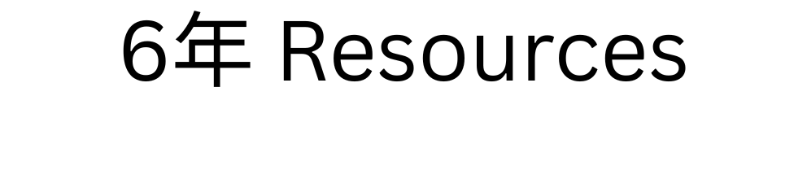
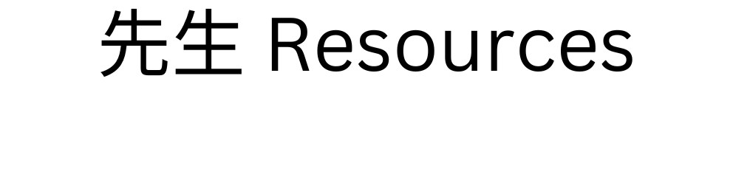
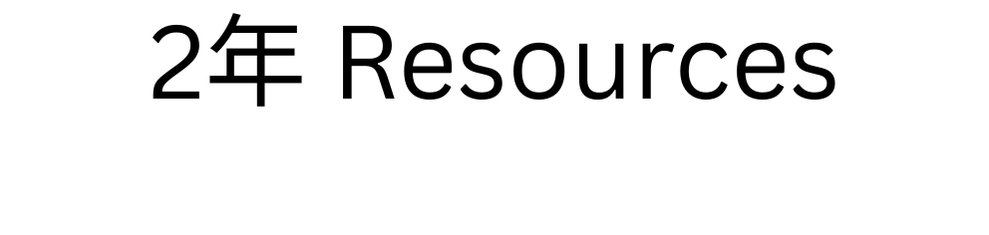

Slide 11
Wellington, New Zealand
February 6th, 1840
5,300,000 people
268,021 km²
National Bird
Kiwi
National Flower
Kowhai
A nickname for people
from New Zealand
is kiwi!
Did you know?
There are 11
active volcanos and
50 dormant volcanoes
in New Zealand.
There are more sheep than
there are people in New Zealand
5.3 million people AND 25 million sheep!

Slide 12
New Zealand
Can you find this country?
Kobe City
ALT Countries

Slide 13
Columbus, OH
17th State
March 1st, 1803
11,900,510 people
116,099 km²
Saitama 県
USA STATES

Slide 14
Ohio
State Bird
Scissor-Tailed Flycatcher
State Flower
Oklahoma Rose
State Bird
Northern Cardinal
State Flower
Scarlet Carnation
Japan is 377,975 km² with 123,000,000 people
Hyogo Prefecture is 8,400 km² with 5,325,228 people
Kobe City is 552.3 km² with 1,540,000 people
Can you find these states?

Slide 15
Oklahoma City, OK
46th State
November 16th, 1907
4,123,288 people
181,038 km²
Kyoto 県
Oklahoma

Slide 16
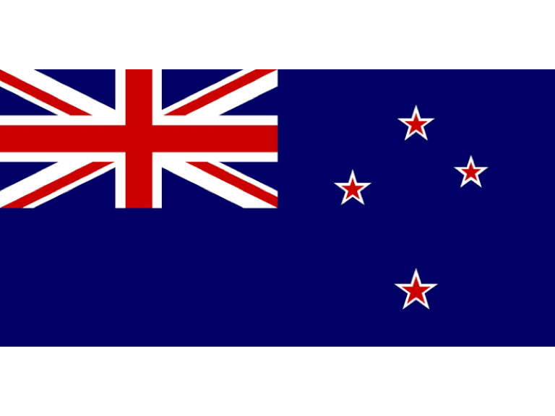

Slide 17
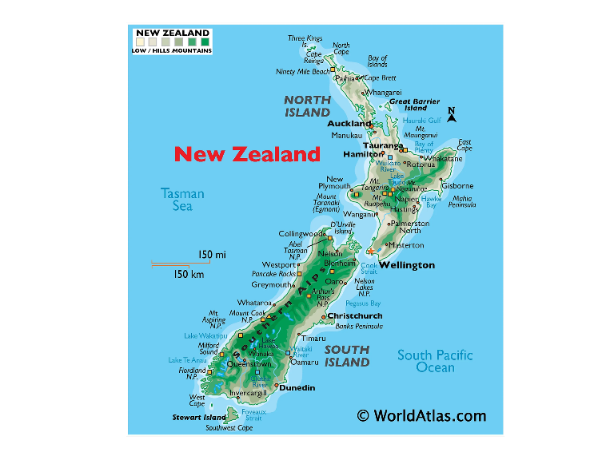

Slide 18
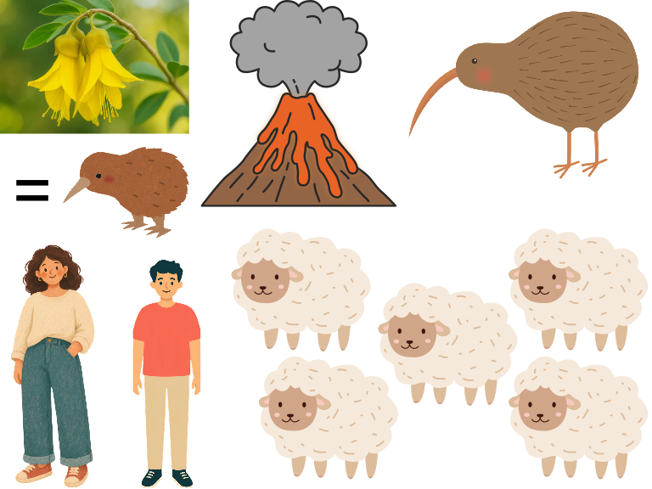

Slide 19
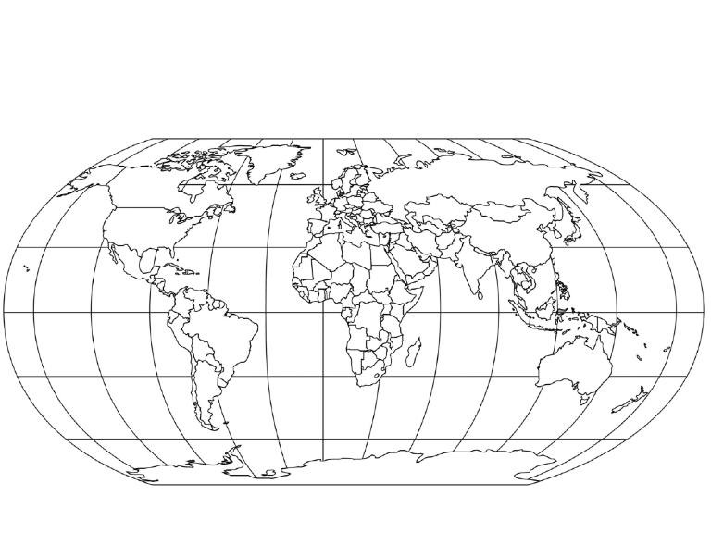

Slide 21
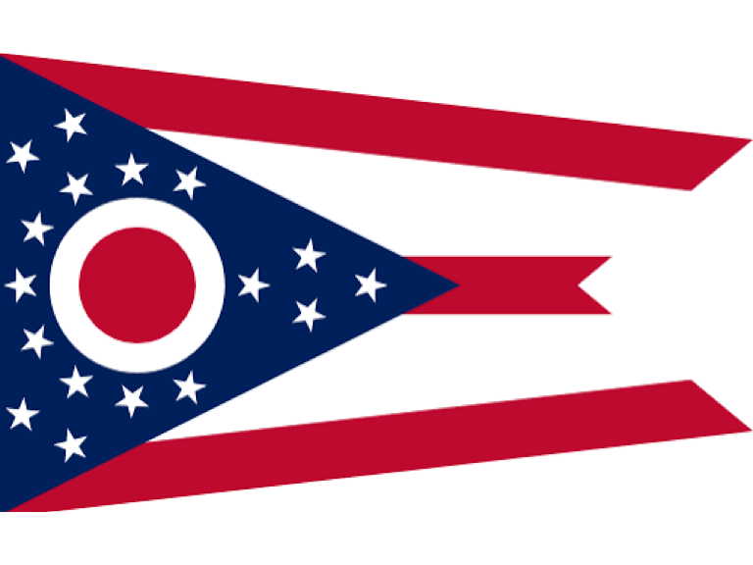

Slide 22
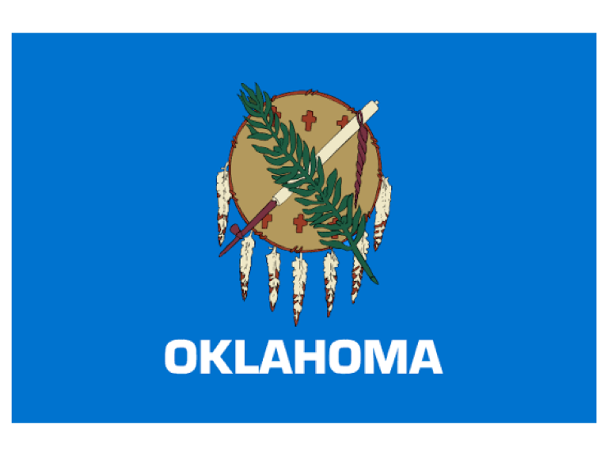

Slide 23
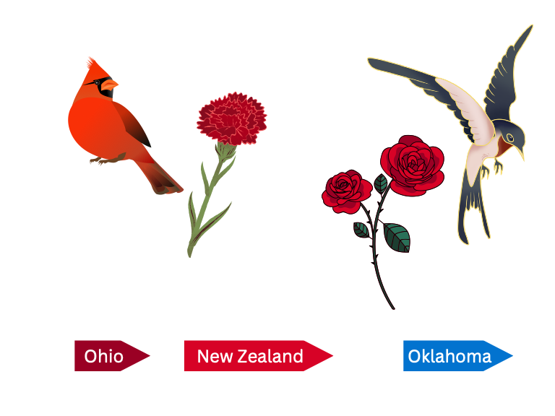

Slide 24
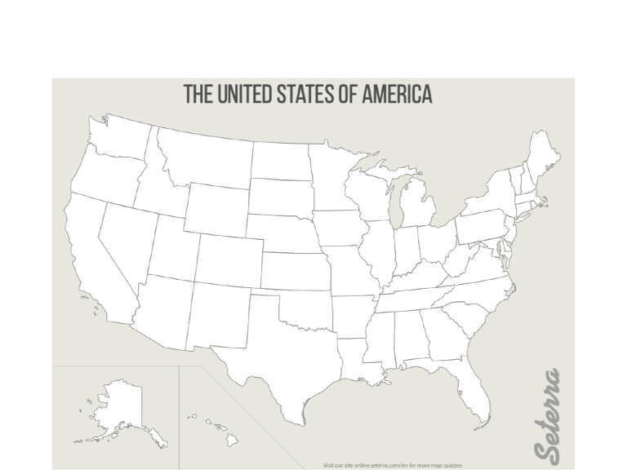

Slide 26
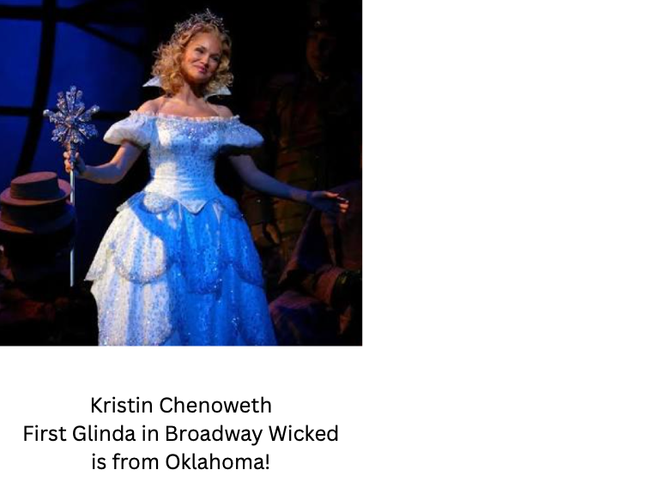

Slide 27
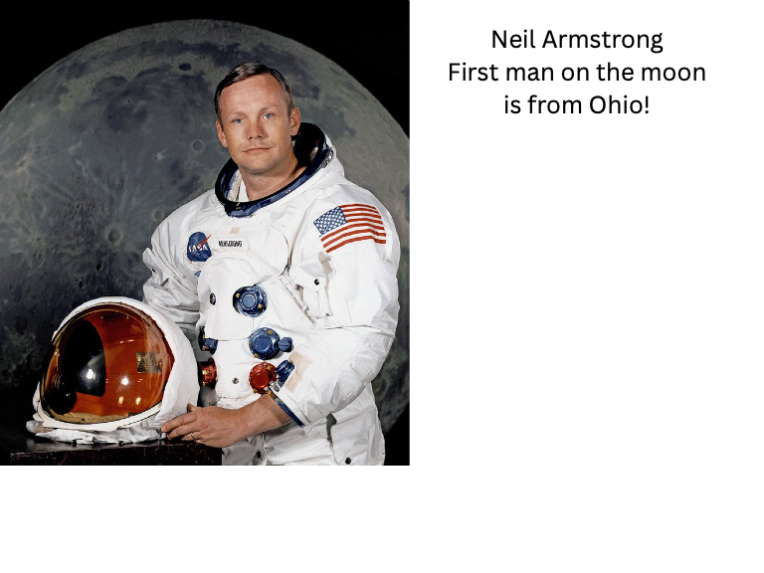

Slide 28
Sound Wall

Slide 29
Sound Wall

Slide 30
Ee

